Slide 1

Microsoft Azure Workshop
David Gristwood
David.Gristwood@microsoft.com
@ScroffTheBad

Slide 2


Agenda 15th Feb 2017
10:00 Welcome + Azure overview | David Gristwood
10:15 Power BI & Embedded | Amy Nicholson
11:00 Azure Search | Bianca Furtuna
11:15 SQL Migration | Will Eastbury
11:45 Coffee
12:15 Getting data into Azure | Amy
12:50 Partnering with Microsoft | Kevin Lief
1pm Lunch
2pm Data, Data, Data Masterclass | Bianca & David
(End 4:30 or so)
#msdevuk #azure
vipazure@microsoft.com
https://github.com/dxuk/
AzureWorkshops
Notes:
Also if cannot use the storage account can still repo demos by using the emulator: https://azure.microsoft.com/en-us/documentation/articles/storage-use-emulator/

Slide 3
What’s next….
Themed Azure workshops
The Intelligent Cloud with Bots masterclass – March 14th
Serverless computing and microservice architectures with Azure Service Fabric Masterclass – April 11th
Azure “best practices” workshops
Implementing Security and Identity in the Cloud – Feb 23rd
Designing Highly Scalable and Available Cloud Solutions – March 23rd
Webinar series
Getting Started on Azure - March 7th
Machine Learning - Feb 21st
Azure Functions & Serverless Computing - March 16th
email vipazure@microsoft.com

Slide 4

https://pollev.com/ukdx
Notes:
https://www.polleverywhere.com/multiple_choice_polls/tB2ywb8sXljcKpp

Slide 5
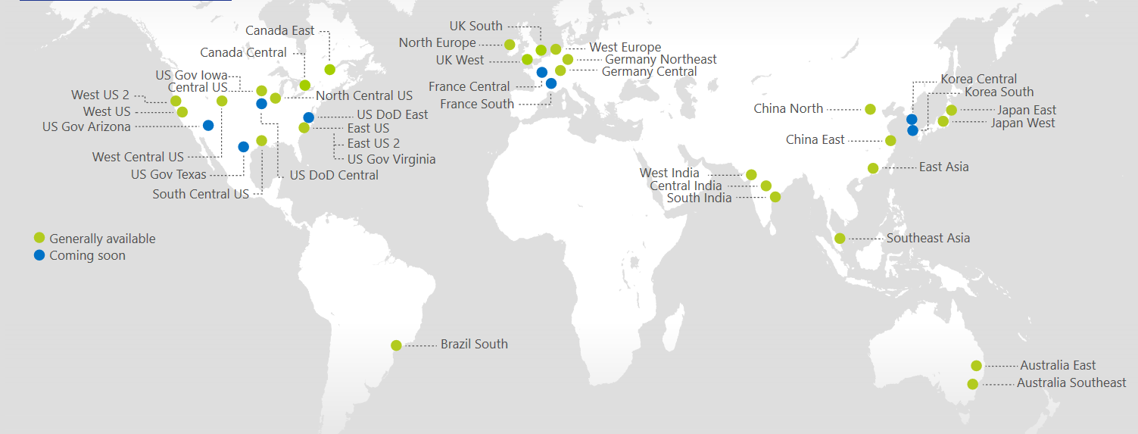
Azure Regions
https://azure.microsoft.com/regions/
Azure is generally available in 30 regions around the world, and has announced plans for 8 additional regions
Notes:
http://azuredatacentermap.azurewebsites.net/

Slide 6
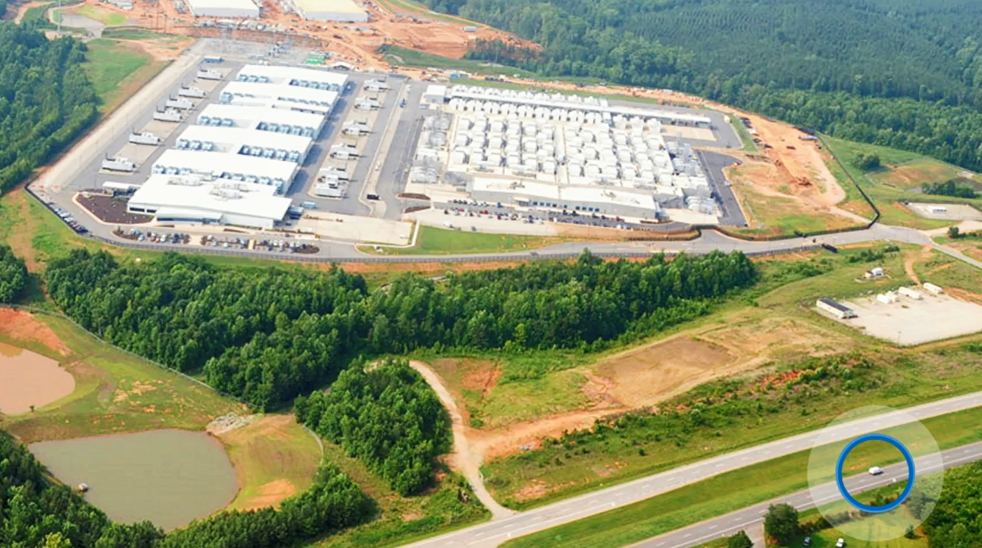

Slide 7

https://www.microsoft.com/en-gb/cloud-platform/global-datacenters
Notes:
https://www.microsoft.com/en-gb/cloud-platform/global-datacenters

Slide 8
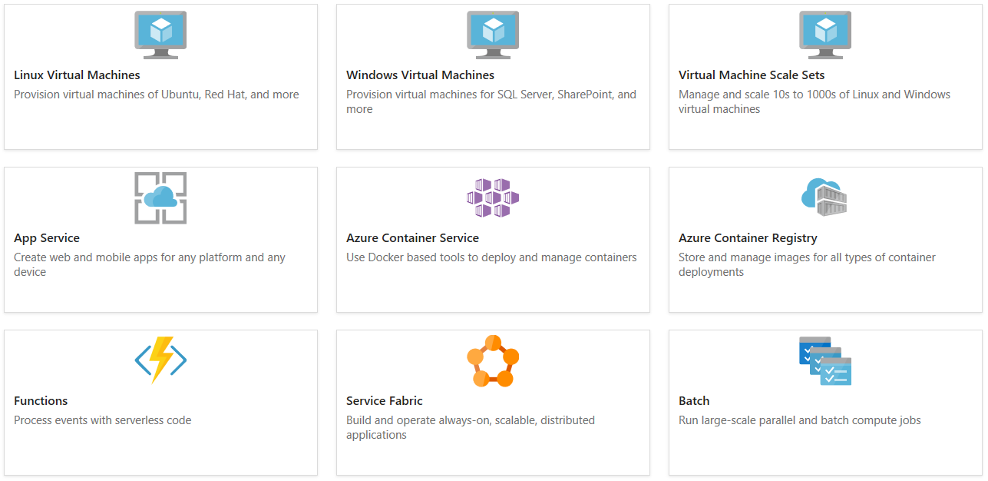
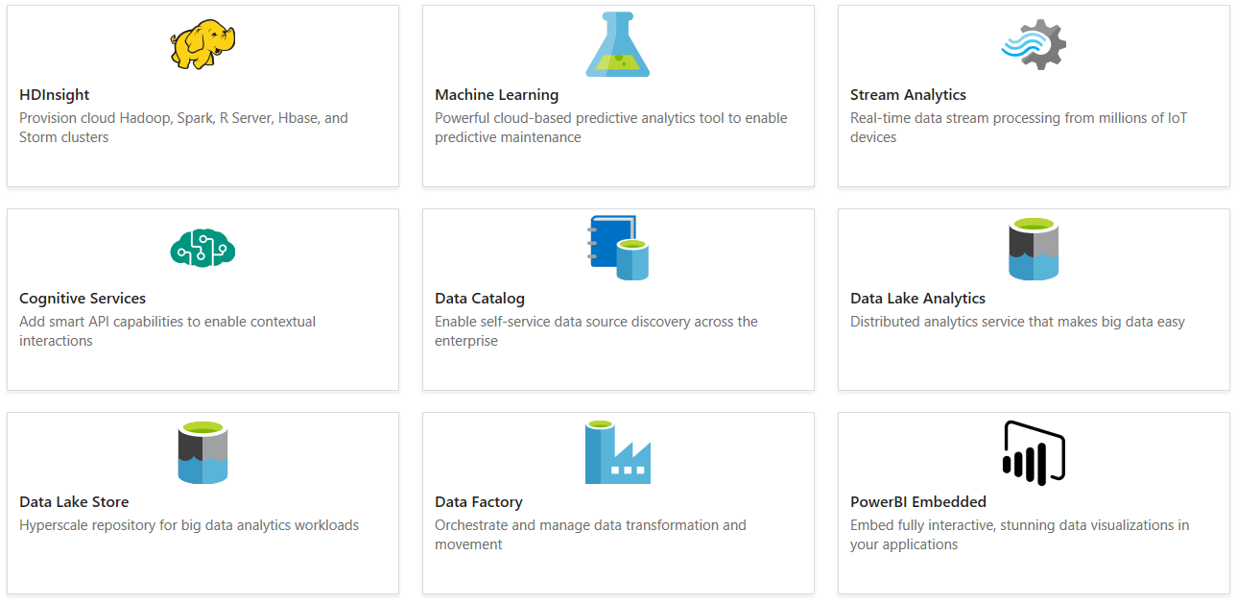
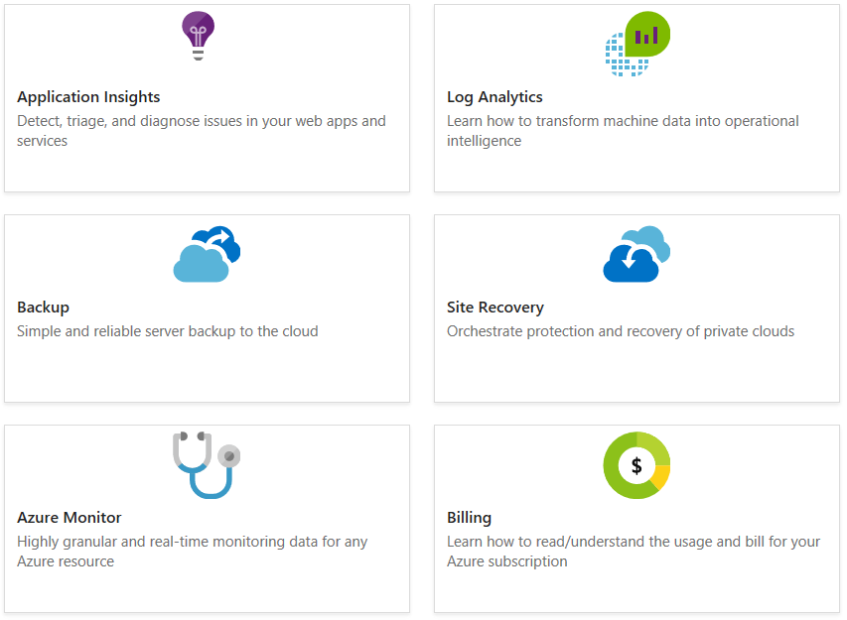
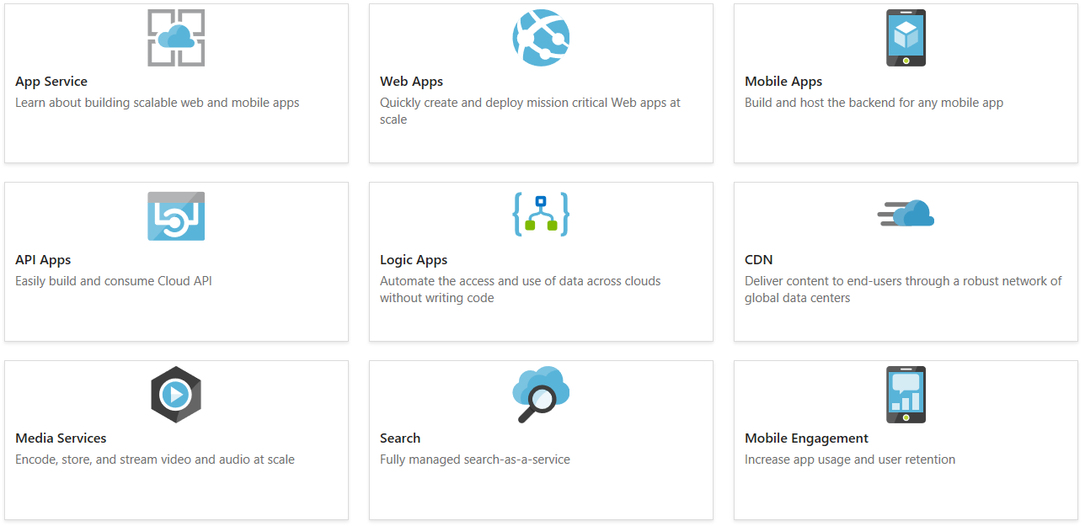
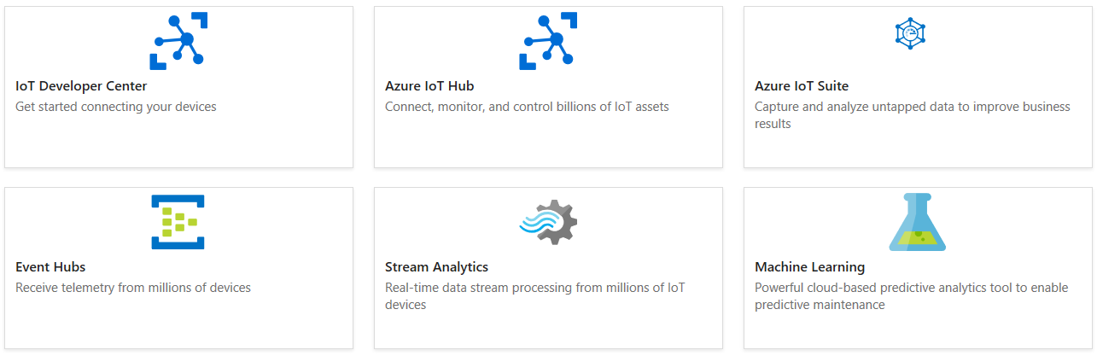
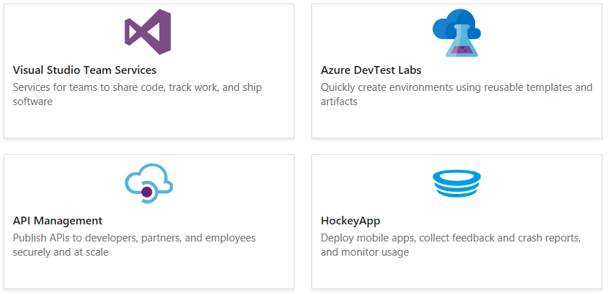
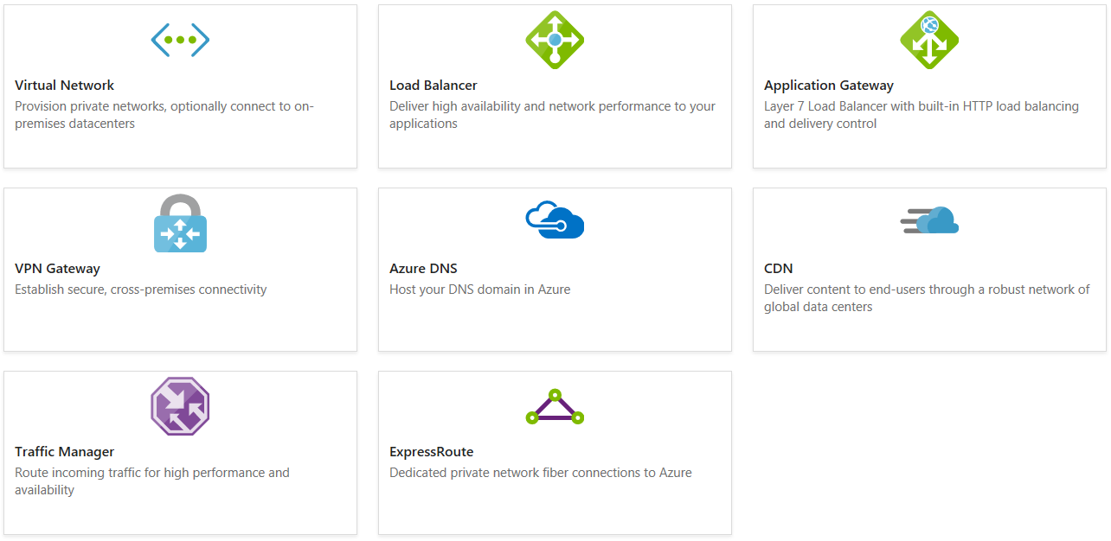
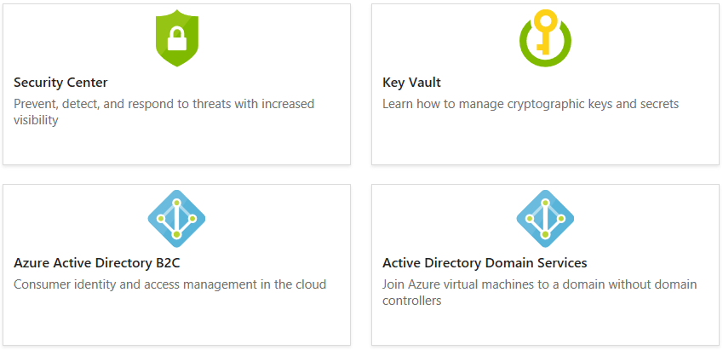
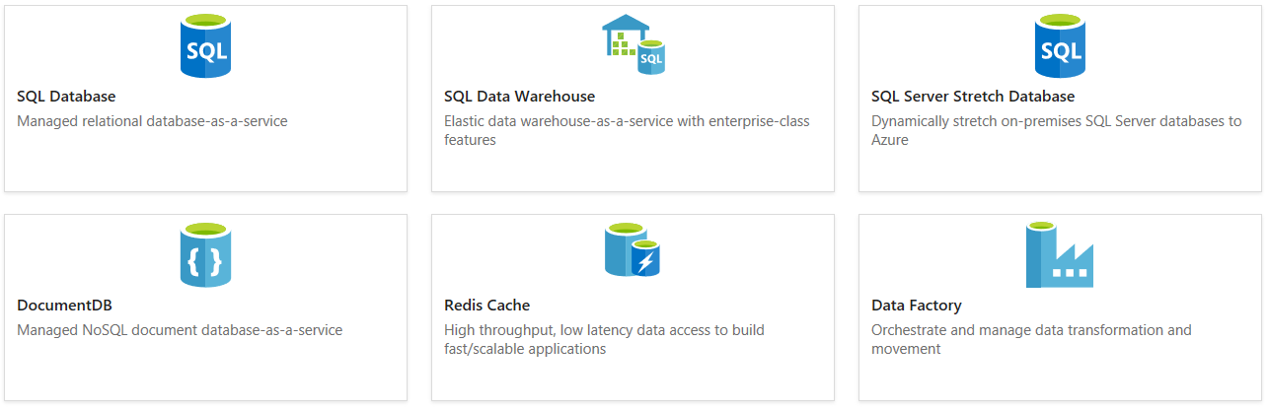
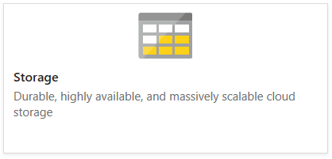
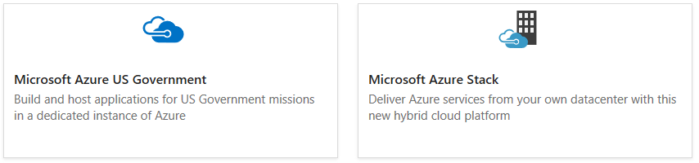
https://docs.microsoft.com/azure/

Slide 9
